Slide 1
La Filiera industriale italiana per il nucleare: capacità ed esperienze
«Il nucleare decisivo per la transizione energetica»
Associazione Italiana Nucleare
Ndic. 15. 2021
Roberto Adinolfi
Ansaldo Nucleare, Presidente

Slide 2



«New Clear» Vision
Nuclear power can and shall take part in this transition
  Short-term
    Timely and efficient solutions for the dismantling of old plants, accelerating the return to green-field of nuclear sites
  Medium-term
    Integrate new flexible and more sustainable nuclear power plants, to make the energy transition smoother and cheaper
  Long-term
    Make fusion available to future energy needs, with the highest sustainability standards for a new source of clean energy
Decommissioning
& Waste
Management
(including national
repository)
2020 - 2035
Small & Advanced Modular Reactors in Hybrid Energy Systems
2030-2040
Fusion Technology
(ITER, DTT, DEMO, SPARC)
2040 - 2050

Slide 3
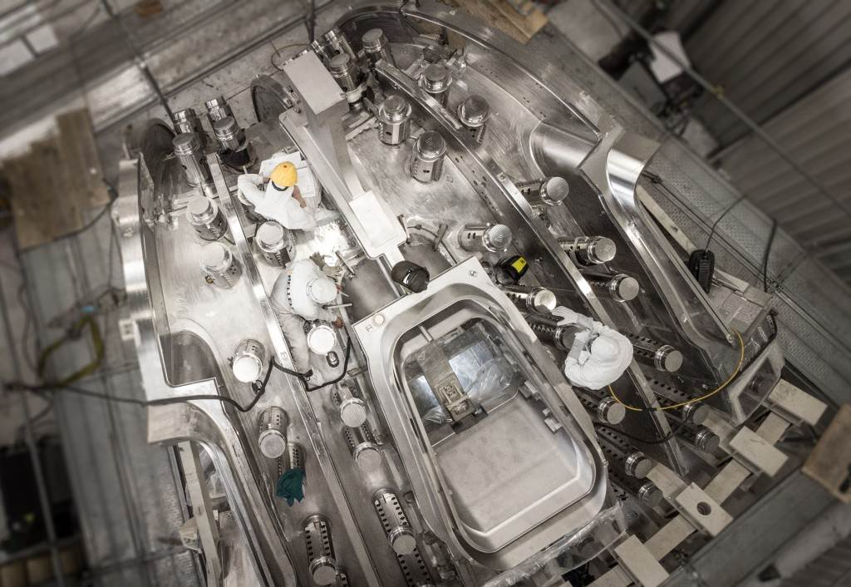
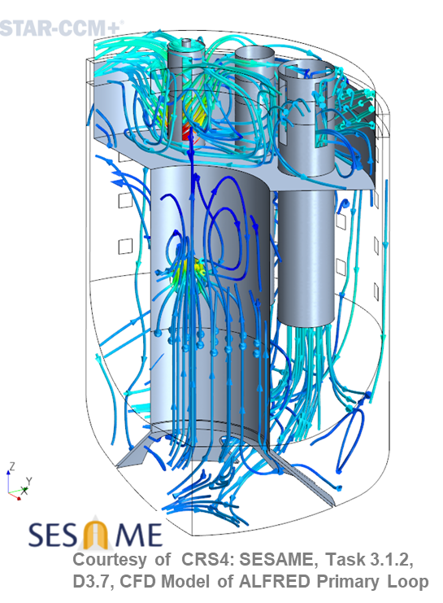
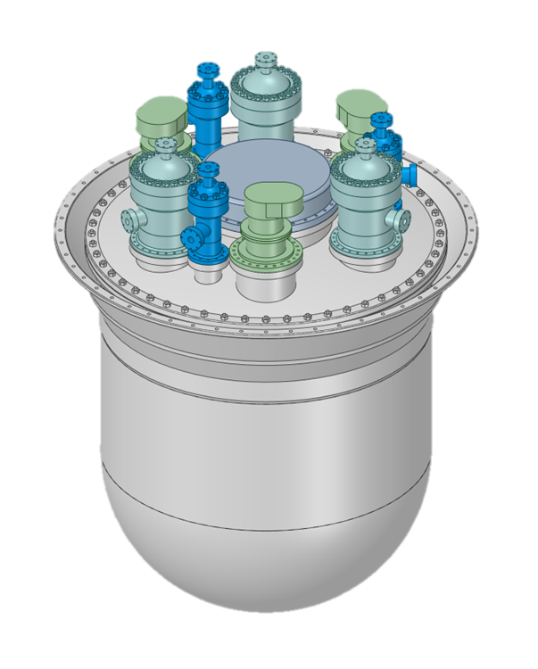
The positioning of the Italian Industry
A vital manufacturing industry, able to compete in Europe
Maintaining engineering skills and competences
Open to innovative designs since 30 years

Slide 4
The Italian Fusion Supply Chain: the second at ITER
ITER Construction Budget
15000
15 B€
21.000 M€
YTD Awarded Tenders
7.2 B€
YTD Tenders Awarded to Italian Industry ⁽¹⁾
1.6 B€
The Italian Fusion Supply Chains accounts for more than 100 enterprises covering the overall Value Chain
YTD Tenders Awarded to Consortia coordinated by Ansaldo Nucleare
0,6 B€
Experimental tests
Applied research
Basic research
EPC (6%)
Raw Materials
Mechanical works
Special tools
Civil works
Technical services
Installations
R&D /(12%)
Manufacturing (17%)
Construction (12%)
Engineering (17%)
Supply Chain Management (36%)
Maintanance
Ansaldo Nucleare is leading contracts for about 40% of the value awarded to the Italian Fusion Supply Chain
Design
Engineering
Specialistic analyses
Other services
EC&I
components
Mech. Components
Bulk materials
Approximate figures in million€
Not including 400 million€ directly awarded by ITER

Slide 5
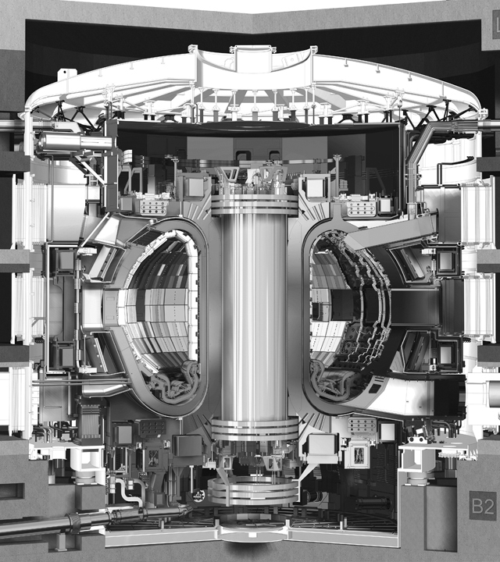
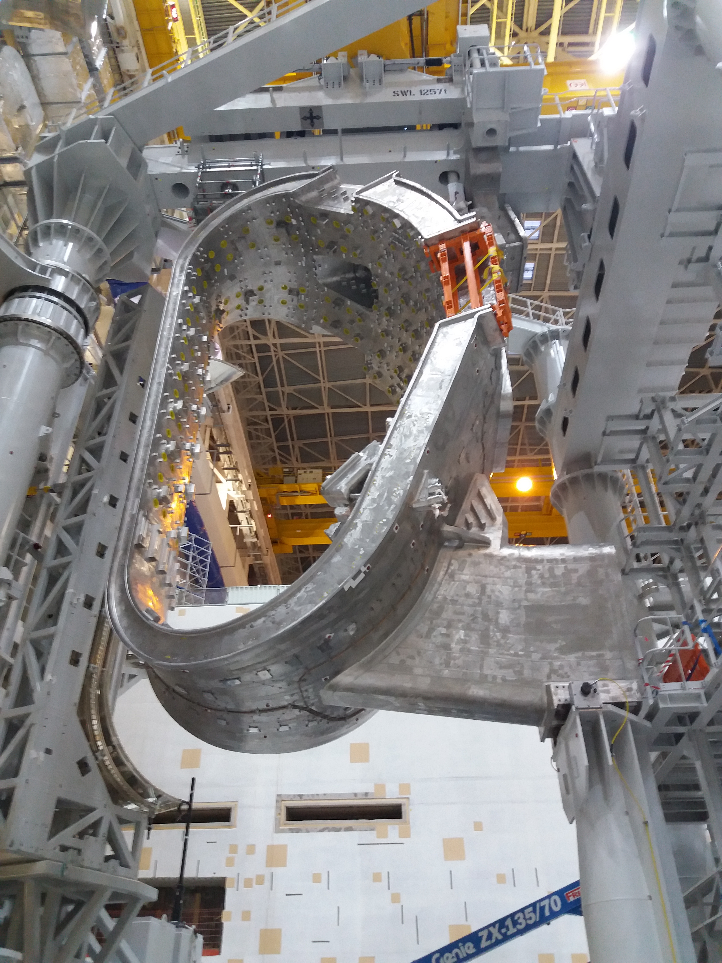
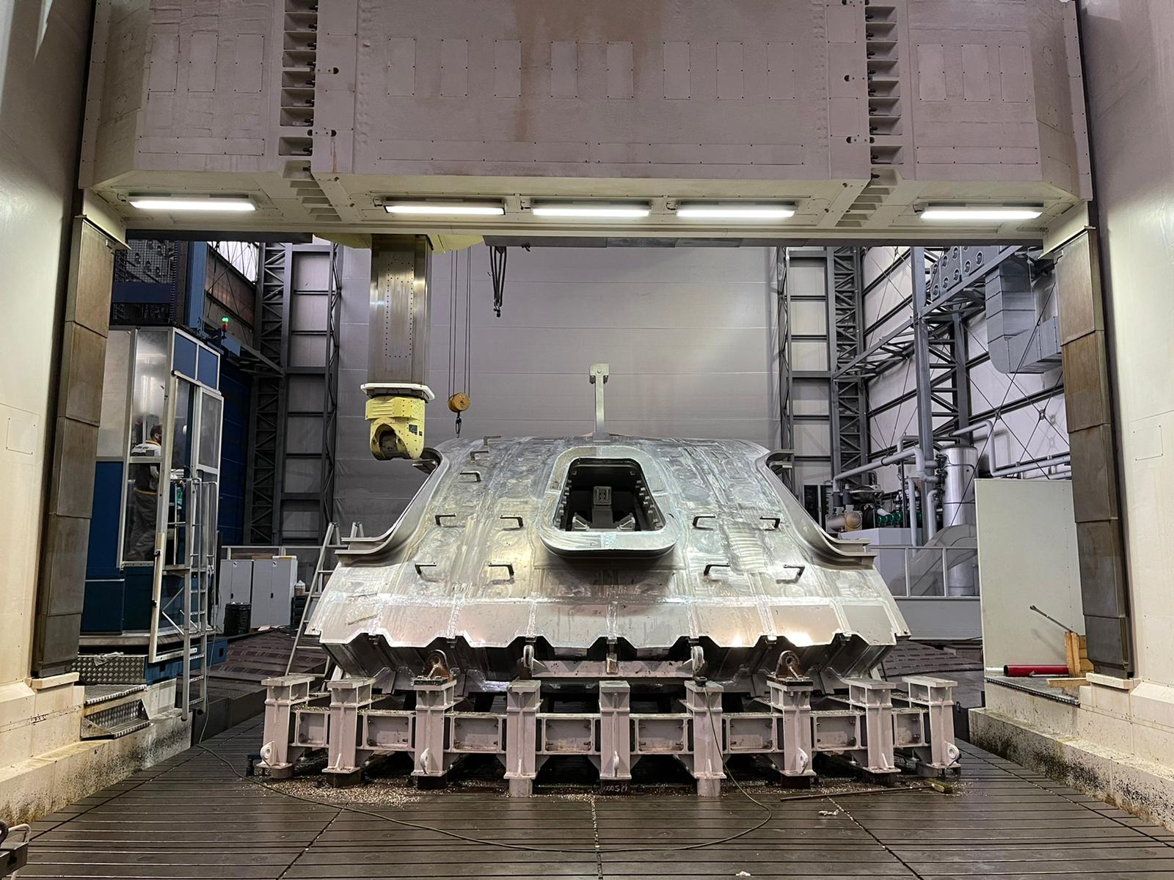
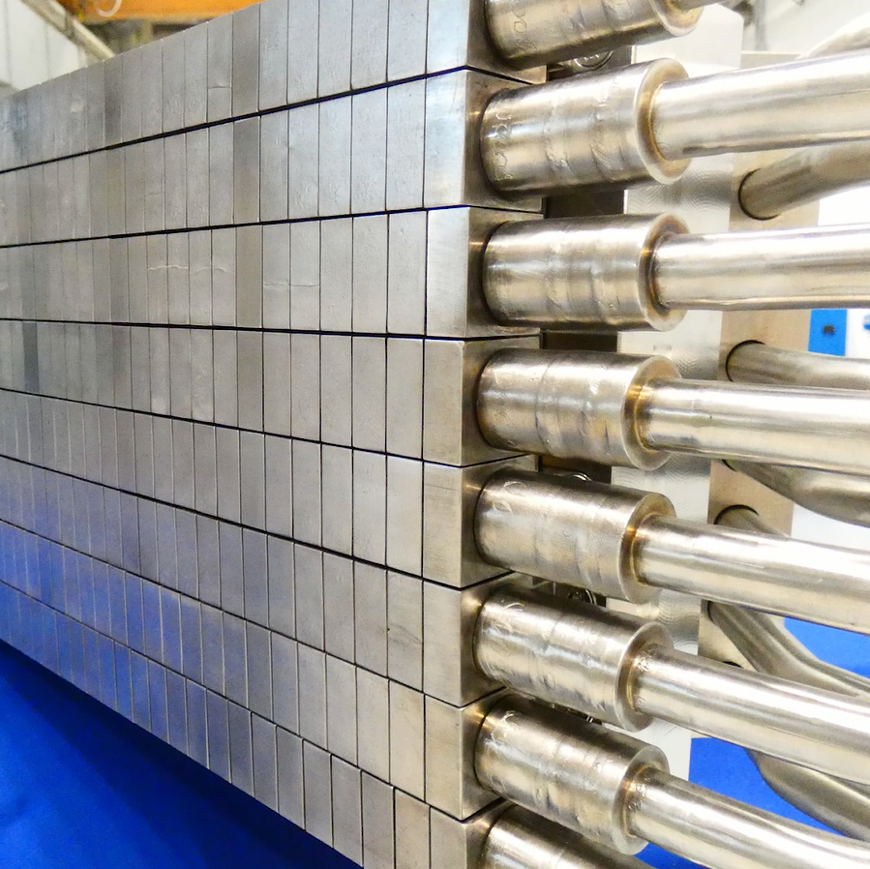
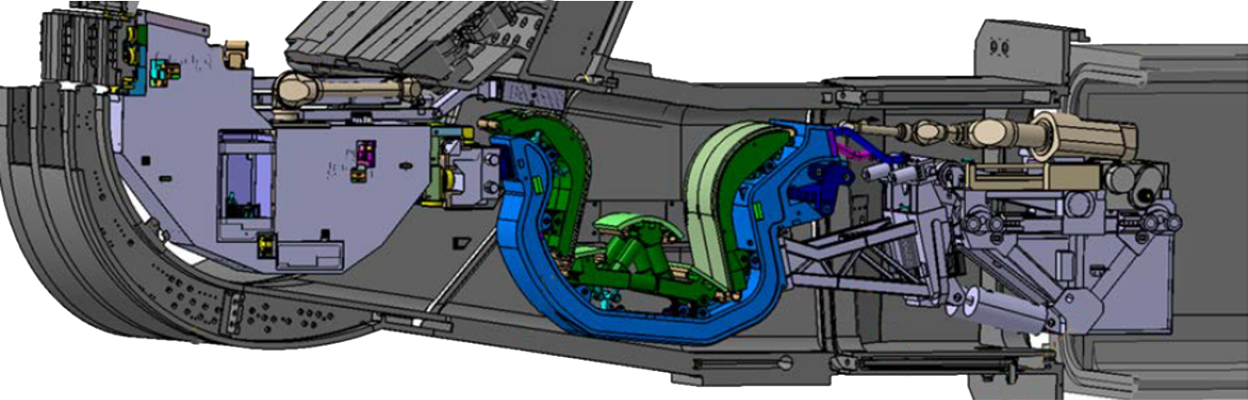
Inside the Tokamak Building
TAC2- Tokamak assembly
Vacuum Vessel manufacturing
Divertor development & testing
Remote Handling

Slide 6
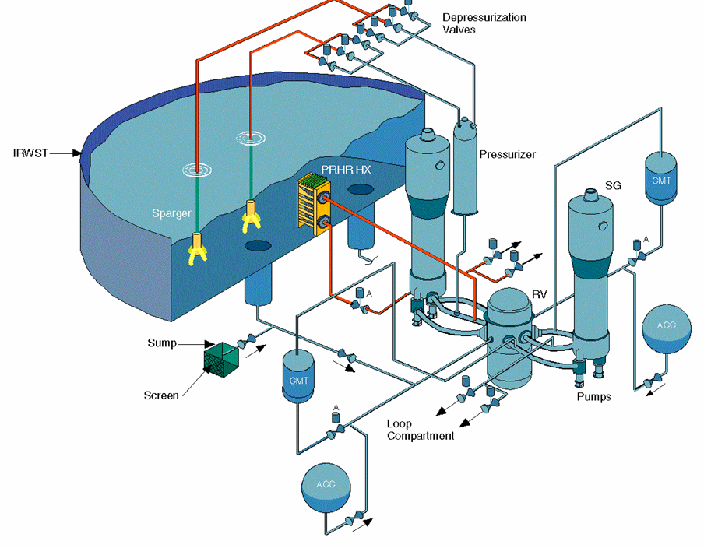
Skills and competences: passive safety feature design
Automatic depressurization
Alternate
actuation
patent
Passive Decay Heat Removal
Conceptual &
detailed
Design PRHX
Fluid System Design
Accident Analyses For Plant Licensing Including Computer Codes Update (Chapter 15)
Thermal Hydraulic Analyses
Testing Support for Licensing
Component Design
Piping and Leak Before Break Analyses
Plant General Arrangement & PDS 3D Model
Structural Analysis
Testing of
steam discharge
in pool
Passive Safety Injection
Full height
integral testing
AP1000 Certification & FOAKE

Slide 7


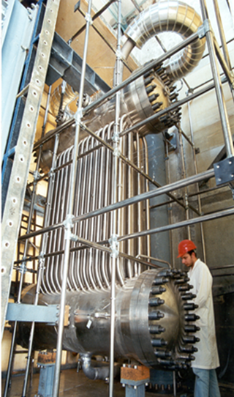
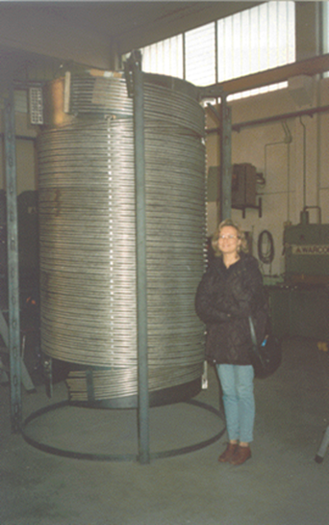
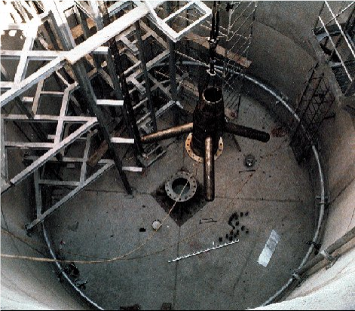
Skills and competences: passive safety feature testing
Atmospheric Depressurization hydrodynamic tests
(ENEA Casaccia)
SBWR Isolation Condenser and Passive Containment Cooling HX- SIET Piacenza
Helical SG Test Rig (20 MW) – SIET Piacenza

Slide 8

Ansaldo Group and Nuclear Innovation
Continuous investment in Nuclear Innovation
1980s
Early studies on advanced passive systems
1990s
Support to AP600 licensing.
Early studies on ADS concept.
Approx. 2% of Ansaldo Nucleare revenues invested in research, development and innovation.
Additional 20% from external funding sources.
Role: systematizing the researchers’ ideas and acting as inventor for the theorists.
Delivery: EPC of experimental facilities, bespoken innovative components.
Goal: deepen competences, develop new products, reinforce networking.
2000s
Support to IRIS development.
Leader of LFR technology development in EU.
2010s
Innovative components for fission and fusion reactors.
Reference design of ALFRED.

Slide 9
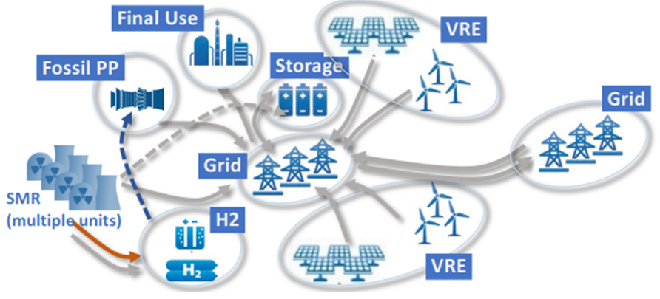
SMR: innovative features to revitalize nuclear industry
Easier Financing: Lack of economy of scale compensated by standardized series production Financial risk reduced by smaller and more diluted capital investment Quicker way to gain investor confidence and reduce financial risk liabilities
Passive safety, favoured by smaller power. Could allow for reduced emergency planning zone. Lead-cooled Fast Reactors offer improved capabilities in terms of passive safety
Sustainability, through reduction of wastes and better use of fuel energy content
Best suited for future hybrid energy systems, both in terms of integration with intermittent renewable energy sources (through thermal energy storage) and co-generation applications (including hydrogen production)

Slide 10
SMR: conditions for success
Standardization
    Needed to grant economy based on series effect
    Requires armonized licensing through various countries
    Allows for abandoning the country-based nuclear industry and creating competitiveness
Robust supply chain
    Smaller unit size requires larger capability for equivalent growth
    Economy based on series effect requires upfront industrial investments
    Allows for better control on final quality
Reduced construction time
    Required to compete with other investment options
    Allows for public confidence to support series construction

